Slide 1

Stock Price Prediction with Machine Learning
Welcome to a deep dive into stock price prediction using machine learning. We'll explore the fundamentals of predicting stock prices, focusing on Apple (AAPL) as our case study.

Slide 2
Overview of Apple Stock
Historical Performance
Market Cap
Financial Performance
Apple's stock has experienced significant growth over the years. It has consistently outperformed many other tech companies.
Apple is currently one of the largest companies in the world by market capitalization, which represents the total value of all outstanding shares.
Apple's strong financial performance, driven by its diverse product portfolio, has contributed to its stock's success. Its products include iPhones, Macs, iPads, and wearable devices.

Slide 3

Data Collection and Preprocessing
1
Data Sources
We'll utilize historical stock data from reputable financial platforms, such as Yahoo Finance or Google Finance.
2
Data Cleaning
Removing missing or inconsistent data points is crucial. We'll handle any outliers and ensure data integrity for accurate analysis.
3
Feature Engineering
We'll transform raw data into features that can be used by machine learning algorithms, such as moving averages or technical indicators.

Slide 4

Machine Learning Algorithms for Stock Prediction
1
Linear Regression
3
Pandas
This algorithm finds a linear relationship between historical stock prices and future predictions.
It is used to convert the data into the table. It also reads the data from the csv file.
2
Neural Networks
4
Matplotlib
Neural networks excel in capturing nonlinear relationships in time series data, providing more accurate predictions.
It is used to plot the predicted and actual values of the stock in the graph and is also easy to understand the difference between the stock prices.

Slide 5

Feature Engineering and Selection
Feature
Description
Opening Price
Price at the start of the trading day.
Closing Price
Price at the end of the trading day.
Volume
Number of shares traded during the day.
Moving Averages
Average of stock prices over a specific period.
Technical Indicators
Signals derived from price and volume data to identify trends and patterns.

Slide 6




Model Training and Evaluation
Model Training
We'll train our chosen model on a portion of the historical data, allowing it to learn patterns and relationships.
Evaluation
We'll assess the model's performance using metrics like mean squared error (MSE) or R-squared.
Optimization
Fine-tuning the model's parameters and choosing the best model based on evaluation results.

Slide 7
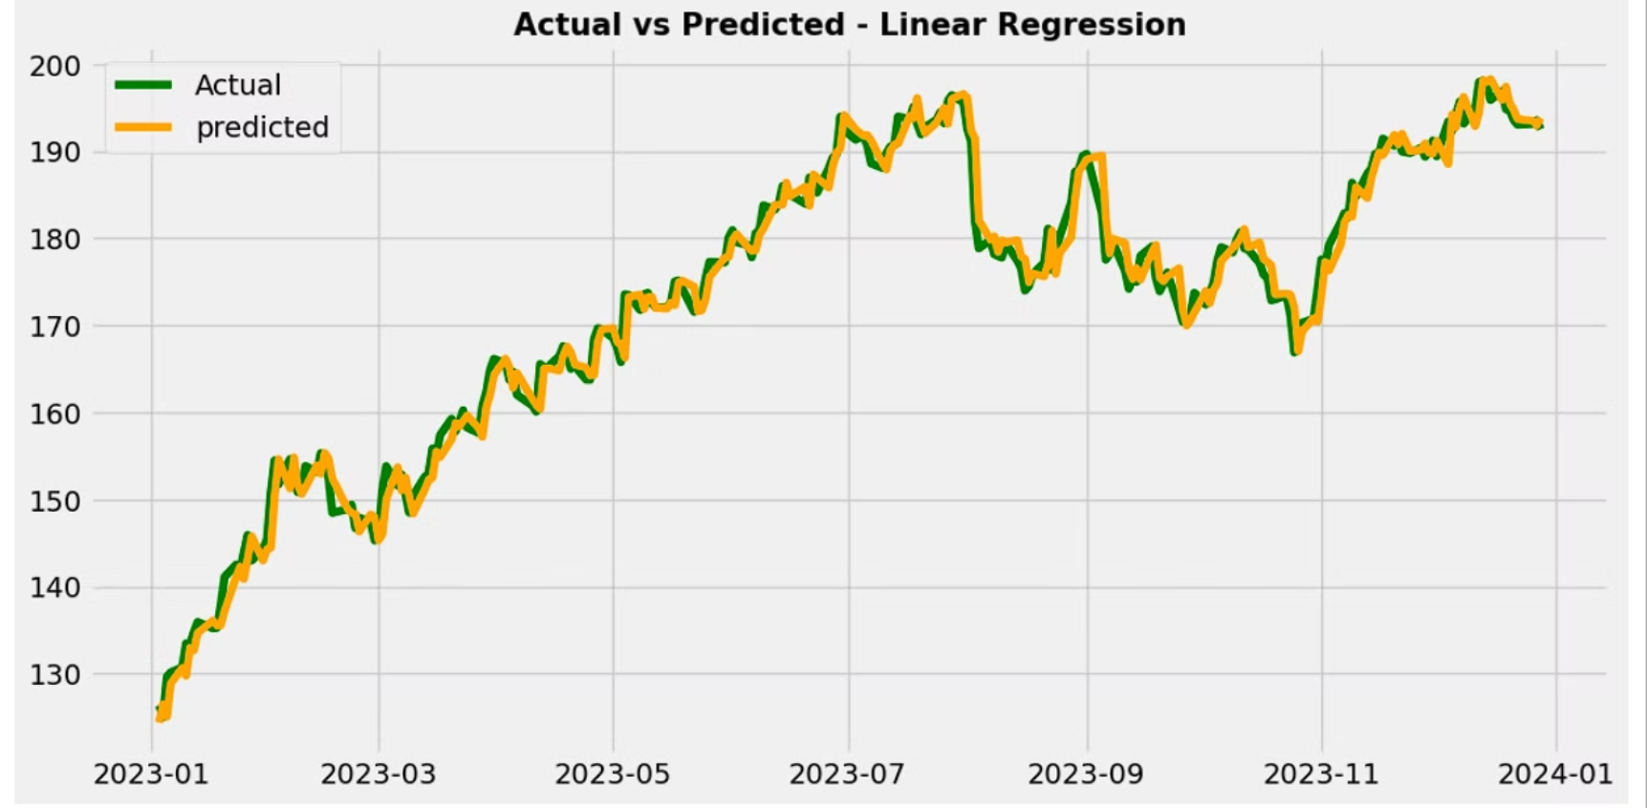
Actual vs. Predicted Stock Prices

Slide 8




Conclusion and Key Takeaways
Data-Driven Predictions
Machine learning enables us to make more informed stock price predictions by analyzing historical data.
Model Performance
While not perfect, machine learning models can provide valuable insights and potentially improve investment decisions.
Market Dynamics
Stock prices are influenced by various factors, including economic conditions, company performance, and investor sentiment.

Slide 9
THANK YOU
PRESENTED BY: D VARUN RAJ YUVASHARAN REDDY
PAWAN KALYAN
SAADULLAHA
SIDDHARATH

